Slide 1
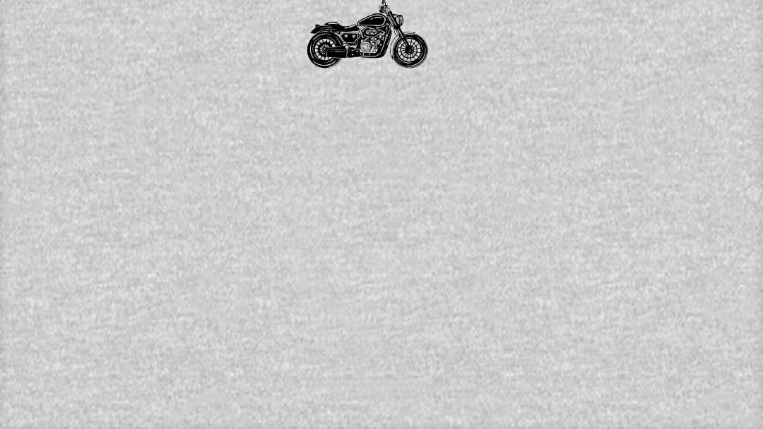
VINTAGE MOTOR CYCLES
by – VASANTH SANJAY
Guided by – PRAISY MAM

Slide 2
ABOUT
Pre-War Classics (1900s-1930s): The early 20th century saw the birth of motorcycle manufacturing, with brands like Harley-Davidson, Indian, and BSA emerging. These motorcycles were rudimentary by today’s standards, often featuring single-cylinder engines and basic suspension. Despite their simplicity, they laid the foundation for modern motorcycling.
Post-War Boom (1940s-1960s): After World War II, the motorcycle industry experienced a boom. Companies like Triumph, Norton, and BMW became household names. This era introduced more powerful engines, innovative designs, and a cultural shift where motorcycles symbolized freedom and rebellion, especially in the 1950s and 1960s.
Vintage motorcycles are classic bikes typically from the early to mid-20th century, prized for their timeless design, craftsmanship, and historical significance. Enthusiasts appreciate these bikes for their unique character, mechanical simplicity, and the nostalgia they evoke. Brands like Harley-Davidson, Indian, and Triumph are iconic in the vintage motorcycle world.

Slide 3

HARDWARE
OS NAME : Microsoft Window 10 Pro
VERSION : 10.0.19045 Build 19045
OS MANUFACTURER : Microsoft Corporation
SYSTEM : LENOVA

Slide 4
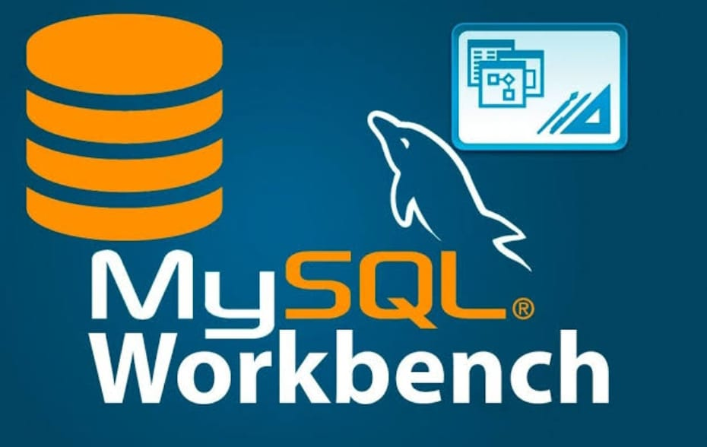

SOFTWARE
MySQL Workbench is a tool for designing, managing, and interacting with MySQL databases. It offers visual modeling for database structures, a query editor for running SQL commands, and administrative features like user management and server monitoring. It's useful for both database developers and administrators to streamline database tasks.
Microsoft PowerPoint is a presentation software that allows users to create slideshows composed of text, images, animations, and videos. It’s widely used for business, education, and personal presentations, making it easy to visually communicate ideas and information.

Slide 5
STRUCTURED QUERY LANUGUAGE
Structured Query Language (SQL) is the standard language for managing and manipulating relational databases. It allows you to create, read, update, and delete data, as well as manage database structures like tables and indexes. SQL is essential for querying databases, defining relationships, and ensuring data integrity.
SQL , DDL , DML , DQL , TCL , DCL , SCALAR FUNCTION
AGGREGATE FUNCTION , SET OPERATORS , SQL CONSTAINTS
JOINS , VIEWS , STORED PROCEDURE , SUB QUERY & TRIGGERS

Slide 6
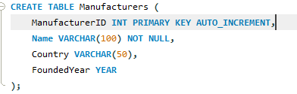
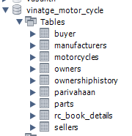
TABLES

Slide 7

DDL
#DDL (DATA DEFINITION LANGUAGE) commands
1.CREATE
2.ALTER
3.DROP
4.TRUNCATE

Slide 8
DML
(DATA MANUPULATION LANUGAGE) COMMANDS
1.INSERT
2.UPDATE
3.DELETE

Slide 9
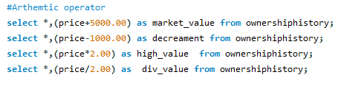
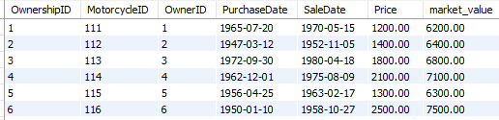
ARITHMETIC
OPERATORS
#In This Arithmetic operators we can use Addition, subraction, Mutipication, division by Using the operators of (+ , - ,* , /) with the help of select QUERY and with the help AS keyword

Slide 10
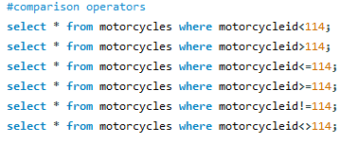

COMPARISON
OPERATORS
Comparison operators in SQL are used to compare two values in a query, and they return a result TRUE, FALSE, or NULL ...

Slide 11
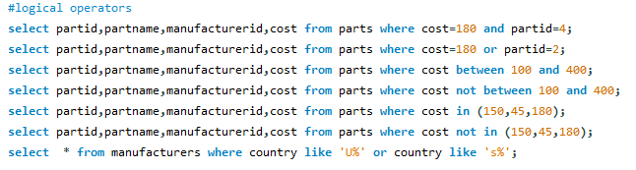

LOGICAL
OPERATORS
SQL logical operators like AND, OR, NOT , IN & LIKE combine or negate conditions in queries. They help you filter data by applying multiple rules.

Slide 12
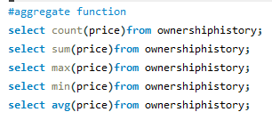





AGGREGATE
FUNCTIONS
In This Aggegate function the particular Column which as the datatype INT , DECIMAL & etc we can the ADD its (SUM),
COUNT the values and we can check MAX , MIN , AVG in this function

Slide 13
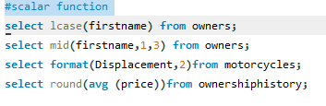
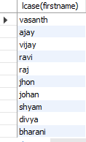
SCALER
FUNCTIONS
In this function we can Use UPPERCASE as ucase and LOWERCASE as lcase it works in the datatype where the VARCHAR AND TEXT appears … and there are
MID , FORMAT , ROUND

Slide 14

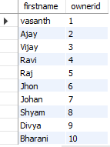
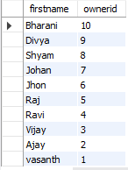

ORDER BY
GROUP BY
ORDER BY are used to make the coloumn record values iwn Ascending
Order and Descending Order with the help of Alphabets and
GROUP BY is used find the values which as repeated records

Slide 15
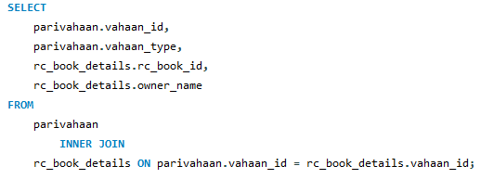
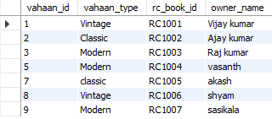
SQL JOINS
INNER JOINS
INNER JOINS are used to join the two
Different tables

Slide 16
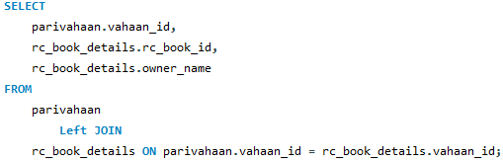
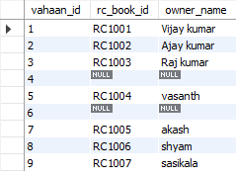
LEFT OUTER
JOINS
LEFT OUTER JOIN If there’s no match, NULL values are returned for the columns from the Right table. This join ensures that all data from the left table is included in the result.

Slide 17
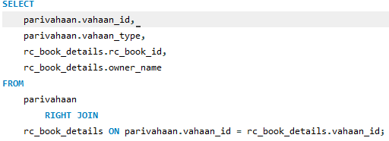
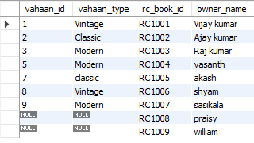
RIGHT OUTER
JOINS
RIGH OUTER JOINS If there’s no match, NULL values are returned for the columns from the left table. This join ensures that all data from the right table is included in the result.

Slide 18
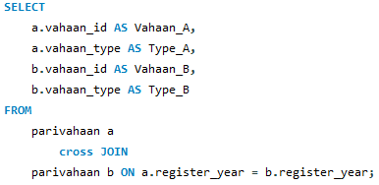
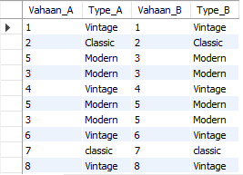
CROSS JOINS
CROSS JOINS as works same AS like INNER JOINS

Slide 19
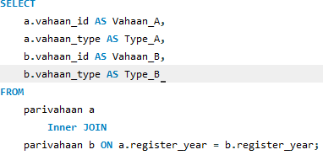
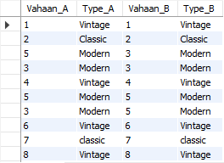
SELF JOINS
SELF JOINS are used to joins the same table with help of A AND B

Slide 20
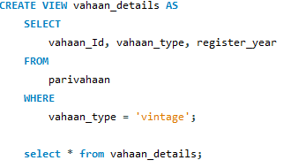
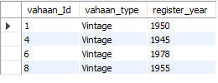
VIEWS
A VIEW is a virtual table created by Queryies and it access to SPECIFIC DATA

Slide 21
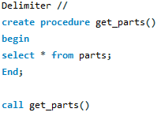
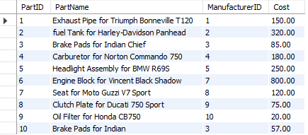
STORED
PROCEDURE
WITHOUT PARAMETER

Slide 22
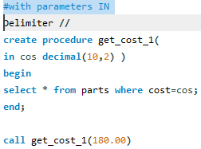

WITH PARAMETERS IN

Slide 23
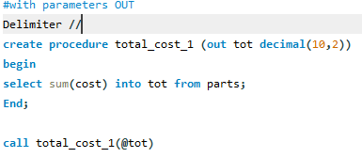

WITH PARAMETERS OUT

Slide 24
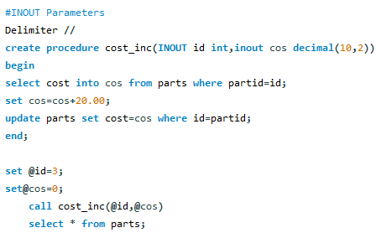
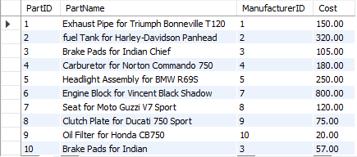
INOUT
PARAMETER

Slide 25
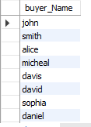
UNION
It combines both the tables without duplicate values. To apply union operation the reserved keyword "UNION" is used.

Slide 26
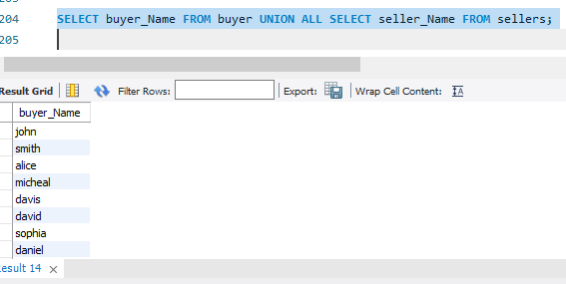
UNION ALL
It combines both the table with duplicate values To implement union all functionality the reserved keyword UNION ALL is used.

Slide 27

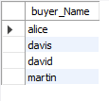
INTERSECT
It combines both the tables with the common records To implement intersection concept, the reserved keyword 'INTERSECT'.

Slide 28
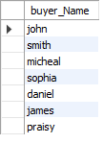
MINUS
It ignores the values which is not matched from the tables To implement the minus operator the keyword 'Minus' is used.

Slide 29
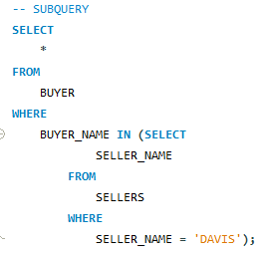

SUB - QUERY
This Sub Query is used to find Similar records from two different tables

Slide 30
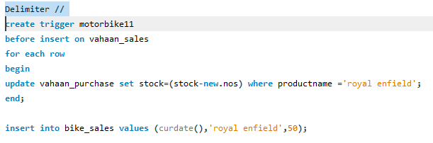

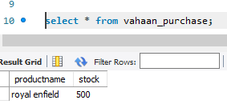

TRIGGERS Which as Inventory records for Example there 2 tables Purchase and sales
Purchase table as a record product name 'royal enfield' and stock 500....
Now you are inserting a values at sales table that 50 royal enfield as
Sold now the purchase table stock as been decreased automatically 500 to 450 By using the query of creating Triggers....
TRIGGERS

Slide 31
THE END

